Slide 1
LinkedIn: Networking, Online Resumes & Job Searching
Instructor: Sherry O’Neal-Hancock

Slide 2
Class Times
1PM-4PM: Class Times
3:30-3:45PM: Break
4-4:30PM: I will stay after class to help with online resume building or job searches

Slide 3

Housekeeping
Setup your laptop and connect to the Internet (use WiFi HotSpot or use your cell phone to create a HotSpot)
or
Use your Smartphone and download the LinkedIn App (doesn’t have as many features)
Have a copy of your resume (even if it is an old version)
If you already have a LinkedIn Account, make sure you have your email address/password before class starts.

Slide 4
Can’t Access Your Old LinkedIn Account?
Forgot Your LinkedIn Password or Email?
  Go to https://www.linkedin.com/help/linkedin/answer/1167
No Longer Have Email Access?
Verify Your Identity
  Go to: http://www.linkedin.com/uas/request-password-reset
  You will need a copy of your Driver’s License or other ID card

Slide 5

Good Profile Headshots

Slide 6
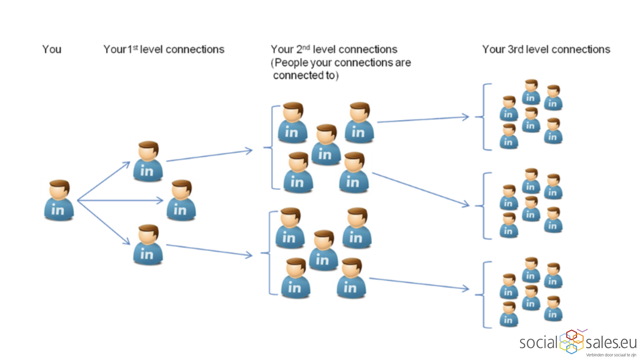
LinkedIn Connection Levels

